Slide 1
Simon Says
By Sam Wynsma and Jarek Thomas

Slide 2
Goals
Our base goal was to get the fsm of a game of Simon Says working. The game only has one round, with the computer choosing 3 colors and the user having to match those colors.
Our next few goals were all about getting the graphics up onto the screen with a four block design and having them flash based off the pattern that the cpu chooses.
Our last goal was to extend that game and by making the computer randomly choose the pattern and have it keep building on that pattern

Slide 3
Individual Tasks
For this project we didn’t really have individual tasks. Just about every part of it we worked on together.
Much of the testing was done on Jarek's computer.
Sam did much of the coding work, as well as decided the list of goals by difficulty.

Slide 4
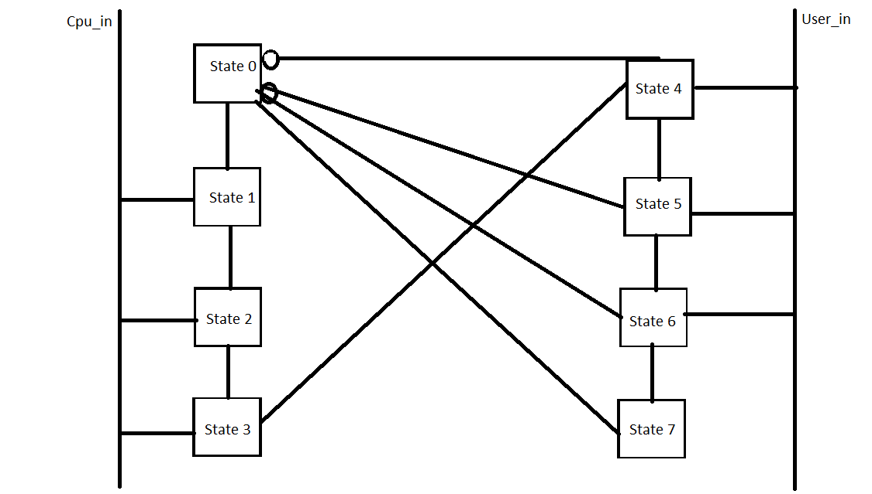
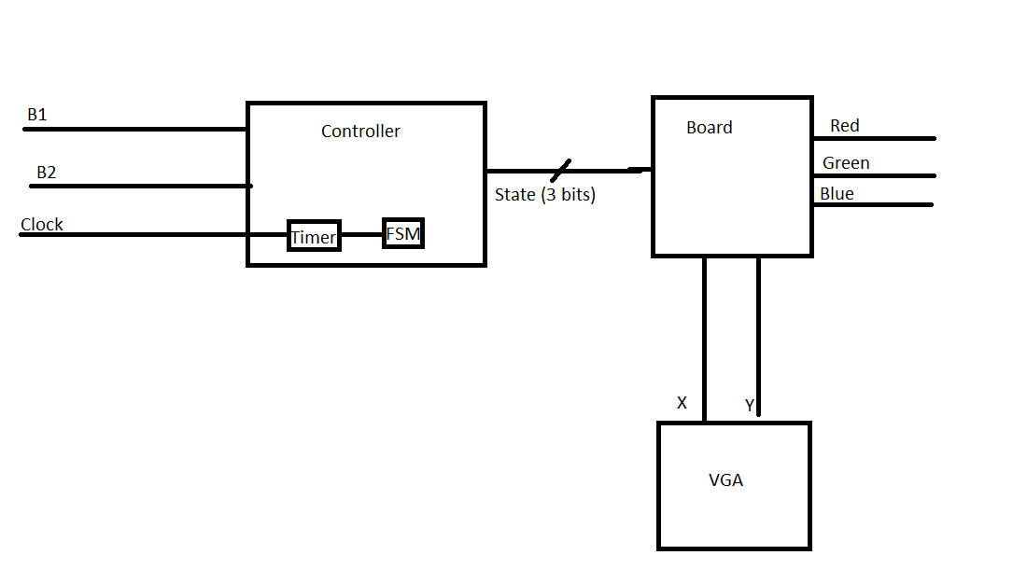
High Level Design

Slide 5
Lessons Learned
Finite state machine design can be rather particular.
Watching assertion statements and writing them correctly
Multiple inputs and assertion statements.
Drawing and flashing boxes in a specific order.

Slide 6
Demo

Slide 7
Conclusion

